Slide 1
4
Foundations
of Decision Making
Copyright ©2017 Pearson Education, Inc.
4-<number>

Slide 2
Learning Outcomes
Describe the decision-making process.
Explain the three approaches managers can use to make decisions.
Describe the types of decisions and decision-making conditions managers face.
Discuss group decision making.
Discuss contemporary issues in managerial decision making.
Copyright ©2017 Pearson Education, Inc.
4-<number>
Notes:
After studying this chapter, you will be able to:
Describe the decision-making process.
Explain the three approaches managers can use to make decisions.
Describe the types of decisions and decision-making conditions managers face.
Discuss group decision making.
Discuss contemporary issues in managerial decision making.

Slide 3
4-1
Describe the decision-making process.
Copyright ©2017 Pearson Education, Inc.
4-<number>

Slide 4
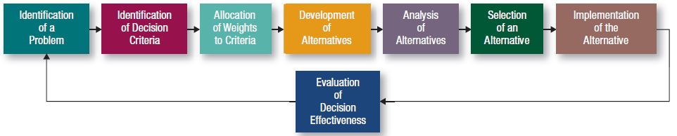
How Do Managers
Make Decisions?
Copyright ©2017 Pearson Education, Inc.
4-<number>
Notes:
Decision making can be viewed as an eight-step process that involves identifying a problem, selecting an alternative, and evaluating the decision’s effectiveness.
This process can be used for making both individual and group decisions, and decisions that range from planning your spring break to complex planning for NASA.
Here we see the eight steps.

Slide 5
Identifying a
Decision Problem
Problem:
a discrepancy between an existing and a desired state of affairs.
Copyright ©2017 Pearson Education, Inc.
4-<number>
Notes:
Step 1 in the decision-making process begins with the identification of a problem—that is, a discrepancy between an existing state of affairs and the desired state of affairs.
How do managers become aware of such a discrepancy? They have to compare the current state of affairs with some standard, which can be past performance, previously set goals, or the performance of another unit within the organization or in another organization. If, for example, a car is no longer worth repairing, then the best decision may be to purchase another car.

Slide 6

Identifying Decision Criteria
Relevant Factors:
  Price
  Model
  Size
  Manufacturer
  Options
  Repair record
Copyright ©2017 Pearson Education, Inc.
4-<number>
Notes:
Once a manager has identified a problem that needs attention, he or she must identify the decision criteria that will be important in solving the problem. This is Step 2 in the decision-making process.
In the case of replacing one’s car, the car’s owner assesses the relevant criteria, which might include price, model (two-door or four-door), size (compact or intermediate), manufacturer (Japanese, South Korean, German, or American), optional equipment (navigation system or side-impact protection), fuel economy, and repair records.
Note that in this step in the decision-making process, what is not identified is as important as what is. Therefore, if a decision maker doesn’t identify a particular factor in Step 2, that factor is deemed irrelevant.

Slide 7
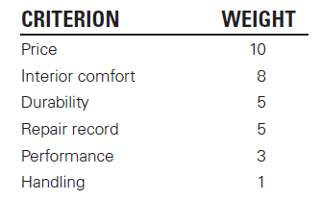
Weighting Criteria
Most important criterion assigned a weight of 10
Other weights assigned against this standard
Copyright ©2017 Pearson Education, Inc.
4-<number>
Notes:
In many decision-making situations, the criteria are not equally important, so it’s necessary to allocate weights to the items listed in Step 2 to factor their relative priority into the decision. This is Step 3 of the decision-making process.
A simple approach is to give the most important criterion a weight of 10 and then assign weights to the rest of the criteria against that standard to indicate their degree of importance. Thus, a criterion that you gave a 5 is only half as important as the highest-rated criterion.
As shown here, Exhibit 4-2 lists the criteria and weights that were developed for the car purchase decision. Price is the most important criterion in this person’s decision; performance and handling having low weights in comparison.

Slide 8
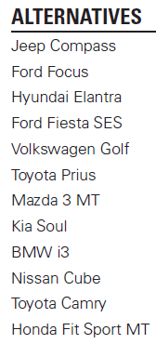
Developing Alternatives
Copyright ©2017 Pearson Education, Inc.
4-<number>
Notes:
In Step 4, the decision maker lists the alternatives that could resolve the problem. The decision maker only lists the alternatives and does not attempt to appraise them in this step. Let’s assume that our subject has identified 12 cars as viable choices: Jeep Compass, Ford Focus, Hyundai Elantra, Ford Fiesta SES, Volkswagen Golf, Toyota Prius, Mazda 3 MT, Kia Soul, BMW 335, Nissan Cube, Toyota Camry, and Honda Fit Sport MT.

Slide 9
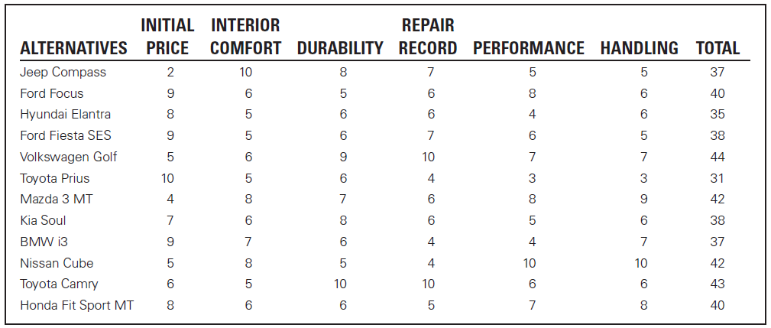
Analyzing Alternatives
Copyright ©2017 Pearson Education, Inc.
4-<number>
Notes:
Once the alternatives have been identified, the decision maker moves to Step 5—that is, critically analyzing each alternative by appraising it against the criteria. The strengths and weaknesses of each alternative become evident when compared with the criteria and weights established in Steps 2 and 3.
Here in Exhibit 4-3 we see the assessed values that the subject put on each of her 12 alternatives after having test-driven each car. Some assessments can be achieved objectively, such as the best purchase price from local dealers and the frequency of repair data as reported by owners in consumer magazine reports.
However, the assessment of how the car handles is clearly a personal judgment. Most decisions contain judgments and these judgments are reflected in which criteria is chosen in Step 2, the weights given to those criteria, and the evaluation of alternatives.
Exhibit 4-3 shows only an assessment of the 12 alternatives against the decision criteria; it does not reflect the weighting done in Step 3. If one choice had scored 10 on every criterion, you wouldn’t need to consider the weights. Similarly, if the weights were all equal—that is, all the criteria were equally important to you—each alternative would be evaluated merely by summing up the appropriate lines in Exhibit 4-3. For instance, the Ford Fiesta SES would have a score of 38, and the Toyota Camry a score of 43.

Slide 10
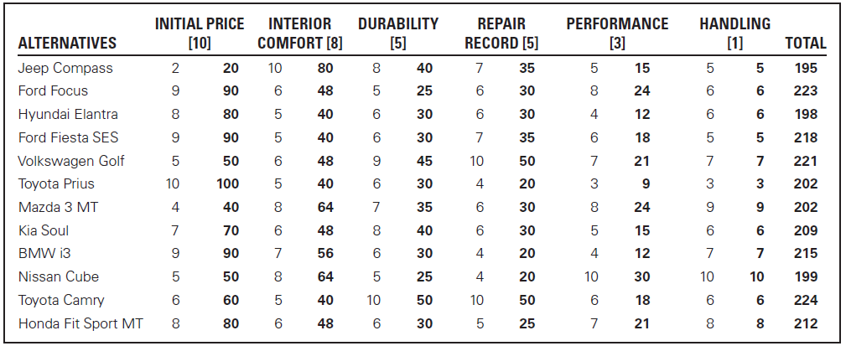
Selecting the Best Alternative
Copyright ©2017 Pearson Education, Inc.
4-<number>
Notes:
If you multiply each alternative assessment against its weight, you get the figures in Exhibit 4-4. For instance, the Kia Soul scored a 40 on durability, which was determined by multiplying the weight given to durability [5] by the manager’s appraisal of Kia on this criterion [8]. The sum of these scores represents an evaluation of each alternative against the previously established criteria and weights. Notice that the weighting of the criteria has changed the ranking of alternatives in our example. The Volkswagen Golf, for example, has gone from first to third. Looking at the analysis, both initial price and interior comfort worked against the Volkswagen.
Step 6 is the critical act of choosing the best alternative from among those assessed. Since we determined all the pertinent factors in the decision, weighted them appropriately, and identified the viable alternatives, we choose the alternative that generates the highest score in Step 5. In our vehicle example—shown here in Exhibit 4-4—the decision maker would choose the Toyota Camry. On the basis of the criteria identified, the weights given to the criteria, and the decision maker’s assessment of each car based on the criteria, the Toyota scored highest with 224 points and thus, became the best alternative.

Slide 11
Implementing the Decision
Decision implementation:
putting a decision into action.
Copyright ©2017 Pearson Education, Inc.
4-<number>
Notes:
Although the choice process is now complete, the decision may still fail if it’s not implemented properly.
Step 7—decision implementation—involves conveying the decision to those affected and to obtaining their commitment. The people who must carry out a decision are more likely to enthusiastically endorse the outcome if they participate in the decision-making process. Also, as we’ll discuss later in this chapter, groups or committees can help a manager achieve commitment.

Slide 12
Evaluating the Decision
Appraising the outcome of the decision
Was the problem resolved?
Copyright ©2017 Pearson Education, Inc.
4-<number>
Notes:
In Step 8, the last step in the decision-making process, managers appraise the result of the decision to see whether the problem was resolved. Did the alternative chosen in Step 6 and implemented in Step 7 accomplish the desired result? Evaluating the results of a decision is part of the managerial control process, which we’ll discuss in more detail in Chapter 14.

Slide 13
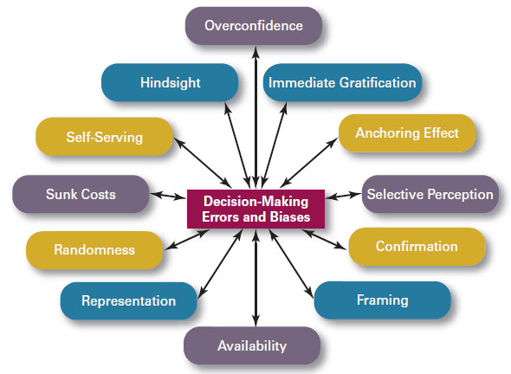
Common Errors
Copyright ©2017 Pearson Education, Inc.
4-<number>
Notes:
When managers make decisions, they not only use their own particular style but also may use “rules of thumb” or judgmental shortcuts called heuristics to simplify their decision making. However, rules of thumb are not necessarily reliable and can lead managers into error while processing and evaluating information.
Exhibit 4-5 shows 12 common decision errors and biases:
Overconfidence occurs when decision makers think they know more than they do or hold unrealistically positive views of themselves and their performance.
Immediate gratification describes decision makers who want immediate rewards but want to avoid immediate costs. For these individuals, decision choices that provide quick payoffs are more appealing than those with payoffs in the future.
The anchoring effect describes when decision makers fixate on initial information—such as first impressions, ideas, prices, and estimates—and then fail to adequately adjust for subsequent information.
Selective perception occurs when decision makers organize and interpret events based on their biased perceptions, which influence the information they pay attention to, the problems they identify, and the alternatives they develop.
Confirmation bias describes decision makers who seek out information that reaffirms their past choices and who discount information that contradicts past judgments. Such people tend to accept, at face value, information that confirms their preconceived views and are critical and skeptical of information that challenges these views.
The framing bias occurs when decision makers select and highlight certain aspects of a situation while excluding others. By drawing attention to specific aspects of a situation and highlighting them, they downplay or omit other aspects, distort what they see, and create incorrect reference points.
The availability bias occurs when decision makers focus on events that are the most recent and vivid in their memory. As a result, their ability to recall events objectively results in distorted judgments and probability estimates.
Representation bias describes how decision makers assess the likelihood of an event based on how closely it resembles other events and then draw analogies and see identical situations where they don’t necessarily exist.
The randomness bias describes when decision makers try to create meaning out of random events.
The sunk costs error occurs when decision makers forget that current choices can’t correct the past. They incorrectly fixate on past expenditures of time, money, or effort rather than on future consequences when they assess choices.
Decision makers exhibiting self-serving bias take credit for their successes and blame failures on outside factors.
Finally, the hindsight bias is the tendency for decision makers to falsely believe that they would have accurately predicted the outcome of an event once that outcome is actually known.
Awareness of these biases helps managers to avoid their negative effects and can encourage them to ask colleagues to identify weaknesses in their decision-making style that the managers can then self-correct.

Slide 14
4-2
Explain the three approaches managers can use to make decisions.
Copyright ©2017 Pearson Education, Inc.
4-<number>

Slide 15
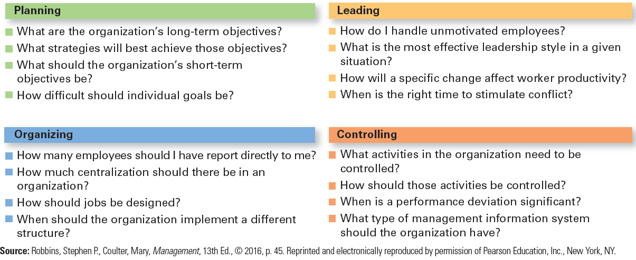
Decisions Managers Make
Copyright ©2017 Pearson Education, Inc.
4-<number>
Notes:
Although everyone makes decisions in an organization, decision making is particularly important to managers and is part of all four managerial functions, as seen here in Exhibit 4-6.
Most decision making is routine, such as deciding which employee will work which shift or how to resolve a customer’s complaint.
Managers can use three approaches to making decisions:
Rational decision making
Bounded rational decision making, and
Intuition.

Slide 16
Rational Model
Rational decision making”
choices that are consistent and value-maximizing within specified constraints.
Rationality is not a very realistic approach.
Copyright ©2017 Pearson Education, Inc.
4-<number>
Notes:
In a perfect world, being a rational decision maker means being fully objective and logical. The problem to be addressed would be clear-cut and the decision maker would have a specific goal and anticipate all possible alternatives and consequences. Ultimately, making decisions rationally would consistently lead to selecting the alternative that maximizes the likelihood of achieving that goal.
For managerial decision making, we need to assume that decisions are made in the best interests of the organization.

Slide 17

Bounded Rationality
Satisfice
Escalation of commitment
A more realistic approach.
Copyright ©2017 Pearson Education, Inc.
4-<number>
Notes:
Since most decisions that managers make don’t fit the assumptions of perfect rationality, a more realistic approach to describing how managers make decisions is the concept of bounded rationality. This means that managers make decisions rationally but are limited (or bounded) by their ability to process information. Because they can’t possibly analyze all information on all alternatives, managers satisfice, rather than maximize. That is, they accept solutions that are “good enough.”
Remember that decision making is also influenced by the organization’s culture, internal politics, power considerations, and escalation of commitment, which is an increased commitment to a previous decision despite evidence that it may have been wrong.

Slide 18
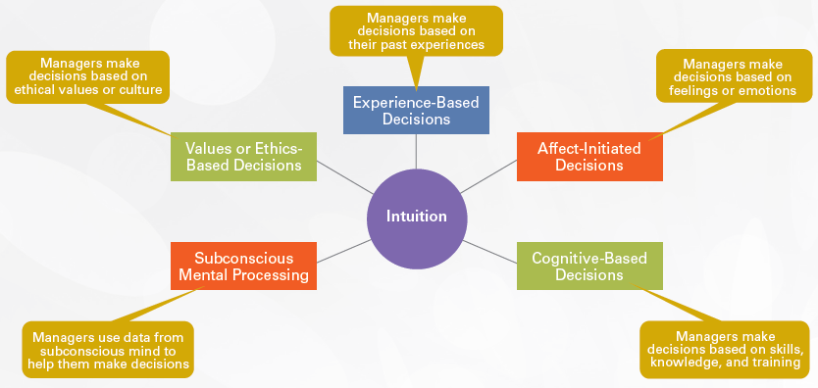
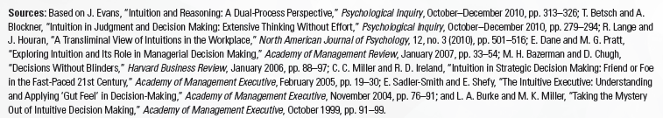
Intuitive Decision Making
Copyright ©2017 Pearson Education, Inc.
4-<number>
Notes:
Intuitive decision making involves making decisions on the basis of experience, feelings, and accumulated judgment, which can complement both rational and bounded rational decision making. Researchers have identified five different aspects of intuition, described here in Exhibit 4-7.
Managers make decisions based on:
Past experiences
Feelings and emotions
Skills, knowledge, and training
Data from the subconscious
Ethical values or culture

Slide 19
4-3
Describe the types of decisions and decision-making conditions that managers face.
Copyright ©2017 Pearson Education, Inc.
4-<number>

Slide 20
Types of Problems
  Structured problem:
  straightforward, familiar, easily defined.
  Unstructured problem:
  new or unusual for which information is ambiguous or incomplete.
Copyright ©2017 Pearson Education, Inc.
4-<number>
Notes:
In a structured problem, the goal of the decision maker is clear, the problem familiar, and information about the problem easily defined and complete. Examples include a customer who wants to return an online purchase or a TV news team that has to respond to a fast-breaking event. These situations are called structured problems because they align closely with the assumptions that underlie perfect rationality.
However, many situations that managers face are unstructured problems—that is, situations that are new or unusual and for which information is ambiguous or incomplete. Entering a new market segment or deciding to invest in an unproven technology are examples of unstructured problems.

Slide 21
Types of Decisions
Programmed:
repetitive decisions that can be handled using a routine approach.
Copyright ©2017 Pearson Education, Inc.
4-<number>
Notes:
Decisions can be divided into two categories, just as problems can. Programmed, or routine, decision making is the most efficient way to handle structured problems.
For example, what does a manager do if an auto mechanic damages a customer’s rim while changing a tire? Because the company probably has a standardized method for handling this type of problem, it’s considered a programmed decision, which tends to rely heavily on previous solutions—such as replacing the rim at the company’s expense.
Managers can use three guides for making programmed decisions:
Procedures
Rules
Policies
A procedure is a series of interrelated sequential steps that a manager can use when responding to a well-structured problem.
A rule is an explicit statement that tells a manager what can or cannot be done.
A policy is a guideline for making decisions.

Slide 22
Types of Decisions
(cont.)
Nonprogrammed:
repetitive decisions that can be handled using a routine approach.
Copyright ©2017 Pearson Education, Inc.
4-<number>
Notes:
Examples of nonprogrammed decisions include deciding whether to acquire another organization or to sell off an unprofitable division. Such decisions are unique and nonrecurring so when a manager confronts an unstructured problem, no cut-and-dried solution is available.
The creation of a new organizational strategy is a nonprogrammed decision. It is different from previous organizational decisions because the issue is new, a different set of environmental factors exists, and other conditions have changed.

Slide 23
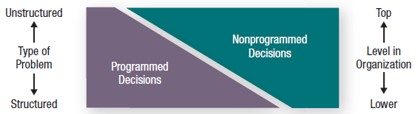
Problems, Decision Types, and Organizational Levels
Copyright ©2017 Pearson Education, Inc.
4-<number>
Notes:
Exhibit 4-8 describes the relationship among types of problems, types of decisions, and one’s level in the organization.
Structured problems are handled with programmed decision making.
Unstructured problems require nonprogrammed decision making.
Lower-level managers usually confront familiar and repetitive problems and typically rely on programmed decisions, such as standard operating procedures. As managers move up the organizational hierarchy, problems are likely to become less structured.
However, few managerial decisions are either fully programmed or fully nonprogrammed. This means that few programmed decisions eliminate individual judgment completely and even the most unusual situation requiring a nonprogrammed decision can often be helped by programmed routines.
Note that programmed decision making facilitates organizational efficiency and minimizes the need for managers with sound judgment and experience, who come at considerable cost.

Slide 24
Decision-Making Conditions
  Certainty
  Risk
  Uncertainty
Copyright ©2017 Pearson Education, Inc.
4-<number>
Notes:
The ideal situation for making decisions is one of certainty, which is a situation where a manager can make accurate decisions because the outcome of every alternative is known.
However, a far more common situation is one of risk, in which the decision maker is able to estimate the likelihood of certain outcomes based on data from past personal experiences or secondary information that lets the manager assign probabilities to different alternatives.
Uncertainty means that the decision maker is not certain about the outcomes and can’t even make reasonable probability estimates. The choice of alternatives is influenced by the limited amount of information and by the psychological orientation of the decision maker.

Slide 25
4-4
Discuss group decision making.
Copyright ©2017 Pearson Education, Inc.
4-<number>

Slide 26
How Do Groups
Make Decisions?
Decisions are often made by groups representing the people who will be
most affected by those decisions.
    Committees
    Task forces
    Review panels
    Work teams
Copyright ©2017 Pearson Education, Inc.
4-<number>
Notes:
Many decisions in organizations, especially important decisions that have far-reaching effects on organizational activities and personnel, are typically made in groups such as committees, task forces, review panels, or work teams.
In many cases, these groups represent the people who will be most affected by the decisions being made because they are often the best qualified to make decisions that affect them.

Slide 27
Advantages of Group Decision Making
  Diversity of experiences/perspectives
  More complete information
  More alternatives generated
  Increased acceptance of solution
  Increased legitimacy
Copyright ©2017 Pearson Education, Inc.
4-<number>
Notes:
Decisions can be made by individuals or by groups—each approach has its own set of strengths and neither is ideal for all situations.
Advantages:
• More complete information.
• Diversity of experiences and perspectives brought to the decision process.
• More alternatives generated due to greater quantity and diversity of information, especially when group members represent different specialties.
• Increased acceptance of a solution by having people who will be affected by a certain solution and who will help implement it participate in the decision.
Increased legitimacy because the group decision-making process is consistent with democratic ideals, and decisions made by groups may be perceived as more legitimate than those made by a single person, which can appear autocratic and arbitrary.

Slide 28
Disadvantages of Group Decision Making
  Time-consuming
  Minority domination
  Ambiguous responsibility
  Pressures to conform
Copyright ©2017 Pearson Education, Inc.
4-<number>
Notes:
Disadvantages:
• Time-consuming—assembling the group, getting decisions made.
• Minority domination can unduly influence final decision because group members are never perfectly equal—they differ in rank, experience, knowledge about the problem, influence on other members, verbal skills, assertiveness, etc.
• Ambiguous responsibility. Group members share responsibility BUT who is actually responsible for final outcome? Individual Decision—it’s clear. Group decision—it’s not.
• Pressures to conform: groupthink, a form of conformity in which group members withhold deviant, minority, or unpopular views in order to give the appearance of agreement.

Slide 29
Groupthink
When a group exerts extensive pressure on an individual to withhold his or her different views in order to appear to be in agreement.
    What it does
    How it occurs
    How to minimize it
Copyright ©2017 Pearson Education, Inc.
4-<number>
Notes:
Groupthink hinders decision making and can jeopardize the quality of the decision by:
• Undermining critical thinking in the group.
• Affecting a group’s ability to objectively appraise alternatives.
• Deterring individuals from critically appraising unusual, minority, or unpopular views.
How does groupthink occur?
• Group members rationalize resistance to assumptions.
• Members directly pressure those who express doubts or question the majority’s views and arguments.
• Members who have doubts or differing points of view avoid deviating from what appears to be group consensus.
• An illusion of unanimity prevails. Full agreement is assumed if no one speaks up.
How can groupthink be minimized?
• Encourage cohesiveness.
• Foster open discussion.
• Have an impartial leader who seeks input from all members.

Slide 30
When Are Groups
Most Effective?
Individual
Faster decision making
More efficient use of work hours
Group
More accurate decisions
More creative
More heterogeneous representation
Greater acceptance of final solution
Copyright ©2017 Pearson Education, Inc.
4-<number>
Notes:
Whether groups are more effective than individuals depends on the criteria used for defining effectiveness, such as accuracy, speed, creativity, and acceptance.
Individuals are faster at decision making.
Groups tend to be more accurate, make better decisions, be more creative, and be more effective in terms of acceptance of the final solution.
With few exceptions, group decision making consumes more work hours than individual decision making does.
Ultimately, primary consideration must be given to assessing whether increases in effectiveness outweigh the losses in efficiency.

Slide 31
Improving Group
Decision Making
Make group decisions more creative by:
    Brainstorming
    The nominal group technique
    Electronic meetings
Copyright ©2017 Pearson Education, Inc.
4-<number>
Notes:
Brainstorming is an idea-generating process that encourages any and all alternatives while withholding any criticism of those alternatives. The group leader states the problem clearly and members then “freewheel” as many alternatives as they can in a given time and all alternatives are recorded for later discussion.
The nominal group technique helps groups arrive at a preferred solution. It restricts discussion during the decision-making process: Group members gather but are required to operate independently. They secretly list general problem areas or potential solutions to problems.
The electronic meeting blends nominal group technique with computer technology. Numerous people sit around a table with a computer terminal. Issues are presented to the participants, who anonymously type their responses onto their computer screens that are displayed on a projection screen. The major advantages of electronic meetings are anonymity, honesty, speed, and cost effectiveness. Discussions do not digress and many participants can “talk” at once without interrupting the others.
The videoconference is a variant, linking media and people from different locations, increasing the efficiency with which decisions are made.

Slide 32
4-5
Discuss contemporary issues in managerial decision making.
Copyright ©2017 Pearson Education, Inc.
4-<number>

Slide 33
Contemporary Issues
National culture:
influences the way decisions are made and the degree of risk involved.
Copyright ©2017 Pearson Education, Inc.
4-<number>
Notes:
Research shows that decision-making practices differ from country to country and two examples of decision variables that reflect a country’s national cultural environment are:
The way decisions are made, whether by group or team members, participatively, or autocratically by an individual manager, and
The degree of risk a decision maker is willing to take.
Decision making in Japan, for example, is group-oriented and values conformity and cooperation. Japanese consensus-forming group decisions, called ringisei, reflect managerial decisions that take a long-term perspective rather than focusing on short-term profits, as is often the practice in the United States.
Managers who deal with employees from diverse cultures need to recognize common and accepted behavior when asking them to make decisions. Those who accommodate the diversity in decision-making philosophies and practices can reap the benefits of capturing the perspectives and strengths that a diverse workforce offers.

Slide 34
Contemporary Issues
(cont.)
Creativity lets the decision maker:
  Understand a problem more fully
  See problems others can’t
  Identify all viable alternatives
Copyright ©2017 Pearson Education, Inc.
4-<number>
Notes:
Creativity allows the decision maker to appraise and understand a problem more fully, “see” problems others can’t see, and identify all viable alternatives.
Most people have the capacity to be at least moderately creative, so individuals and organizations can stimulate employee creativity by adhering to the creativity model, which proposes that individual creativity essentially requires expertise, creative-thinking skills, and intrinsic task motivation.

Slide 35

Contemporary Issues
(cont.)
Design thinking:
approaching management problems as designers approach design problems.
Copyright ©2017 Pearson Education, Inc.
4-<number>
Notes:
More organizations are beginning to recognize how design thinking can benefit them. Apple’s approach: “We try to develop products that seem somehow inevitable. That leave you with the sense that that’s the only possible solution that makes sense.”
The design thinking approach begins with the first step of identifying problems. Design thinking says that managers should look at problem identification collaboratively and integratively with the goal of gaining a deep understanding of the situation. They should look not only at the rational aspects, but also at the emotional elements. Then invariably, of course, design thinking would influence how managers identify and evaluate alternatives.
Design thinking means opening up your perspective and gaining insights by using observation and inquiry skills, and not relying simply on rational analysis.

Slide 36
Contemporary Issues
(cont.)
Big Data:
the vast amounts of quantifiable
information that can be analyzed by
highly sophisticated data processing.
Changing the way managers make decisions.
Copyright ©2017 Pearson Education, Inc.
4-<number>
Notes:
With this type of data at hand, decision makers have very powerful tools to help them make decisions. However, experts caution that collecting and analyzing data for data’s sake is wasted effort. Goals are needed collecting and using this type of information. As one individual said, “Big data is a descendant of Taylor’s ‘scientific management’ of more than century ago.” While Taylor used a stopwatch to time and monitor a worker’s every movement, big data is using math modeling, predictive algorithms, and artificial intelligence software to measure and monitor people and machines like never before. But managers need to really examine and evaluate how big data might contribute to their decision making before jumping in with both feet—benefits of capturing the perspectives and strengths that a diverse workforce offers.

